Slide 1

MNEE Payment Gateway for Joomla Bridging Web2 E-commerce with Trustless Web3 Payments.
Build by Xiyu Gao
Solo Full-Stack Developer

Slide 2
The Problem vs. The Solution
The Pain (Current Solutions):
Centralized Gateways: High fees & frozen funds risk
Manual Transfers: Bad UX, hard to track.
My Solution:
Decentralized: Peer-to-Contract payments. No middlemen.
Self-Hosted: Merchants own their data and keys.

Slide 3
Architecture
Frontend: Joomla Module + Ethers.js (Seamless UX).
Backend Core: Custom PHP Verification Layer utilizing Alchemy RPC Nodes. (Ensures security).
The Tech Stack (Secure & Efficient):

Slide 4
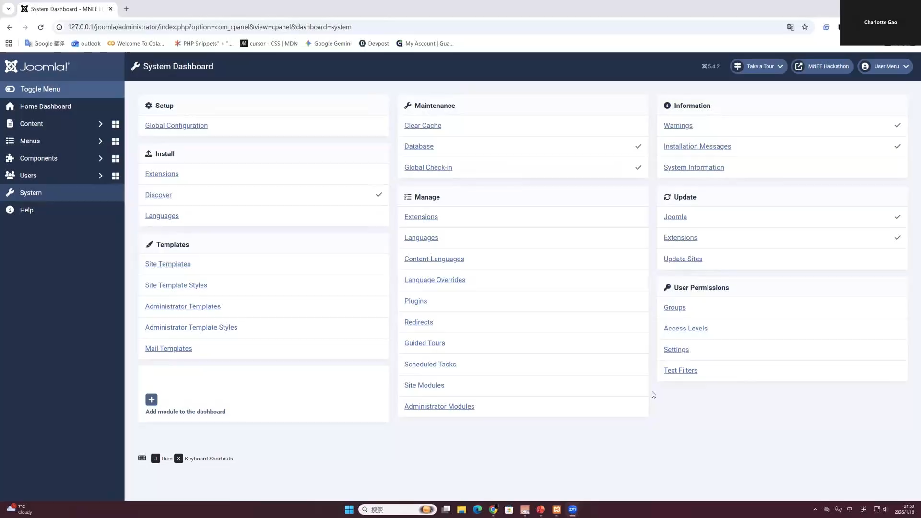

Slide 5
Advantage
1. Zero middlemen: The MNEE goes directly from the customer’s wallet to the smart contract
2. No Monthly Fees
3. Simplicity: zip file

Slide 6
Conclusion & Roadmap
Phase 1: Joomla VirtueMart Integration.
Phase 2: Porting core PHP logic to support WordPress / WooCommerce. (Capturing 40% of the web).

